Slide 1


Slide 2

While You Are Waiting
Please fill out the contact information sheet. You can include more than one email to receive weekly classroom communication.
You can write a note to your child.

Slide 3
Welcome
My name is Stefanie Griffith I am excited to be starting my 16th year of teaching! This is my fourth year teaching 4th grade at STC.
I taught 4th grade for 9 years and second grade for 7 years. I graduated from Rider University and just received my Masters from La Salle University.
Before teaching, I worked in the field of advertising.

Slide 4
Covering Books
Book Covering
-Please have book covering completed by Friday, September 15th.
-All workbooks should be covered using the contact paper that was sent home with your child on the first day of school. Please write their name and number somewhere on the front or the spine of the book.
-Students will also have 3 textbooks this year that they will need book sox for. They will need at least one JUMBO book sox for their Journey's book.

Slide 5

Important Notes
All treats brought into class need to be nut free (Also no sesame seeds).
Labeling books, pencil cases, clothing, lunchboxes, folders.
My website includes information and resources for all subjects.

Slide 6

Sadlier-Oxford: Progress in Mathematics
All addition, subtraction and multiplication facts need to be mastered. Knowing math facts with speed and accuracy will ensure future success.
I have many enrichment activities listed on my website under resources to help review math facts as well as all subject areas.

Slide 7

IXL
*Logins go year-round and content is aligned with common
core standards.
*Homework or review can be assigned that matches topics
being studied in class.
*Every lesson is reinforced by interactive questions, vivid
visuals, and enticing awards—all to engage and inspire
students!
*Can use on iPads and tutorial information is offered for
students to show them how to do problems.

Slide 8

Book Reports
There is detailed information as well as the rubric for the required book reports listed on my website.
There are 3 graded book reports required during the year. I will be going over this with students and will send home a hard copy of the assignment.
The goal is to develop a love of reading.

Slide 9

Scholastic
A letter will be sent home on how you can order Scholastic books and there is a tab on my website as well.
The first order will be placed September 22.

Slide 10

Journeys
The students will have weekly spelling and reading tests. The weekly reading test consists of: reading comprehension, grammar, vocabulary meanings and skills.
See the ELA copybook for a list of spelling words and skills each week.
Students have user names and passwords for Think Central glued into the homework book.

Slide 11

Science: LabLearner
It is important to visit the science tab on my website to have your child review the vocabulary PowerPoints learned in class.
LabLearner tests are challenging and ask students to apply concepts learned. I will add a vocabulary section to all tests.
Students should be using Quizlet to review on a daily basis. I will send home information about this.

Slide 12
Social Studies
Students will be learning about:
•The geography of our state
•Americans and their history
•Government in the United States
•The nation’s economy
•Pennsylvania history and state symbols
Check the Social Studies tab on Mrs. Dusing’s website for resources throughout the year! Mrs. Dusing posted a link to access the student textbook online.

Slide 13

Student of the Week
Beginning September 18th we will be highlighting a student of the week in our classroom. This student will be called the Top Dog of the Week.
Poster to be presented Monday.
Privileges: choosing his/her job for the week, having one night of no written homework for the week, being the subject of our weekly writing prompts, and helping the teacher throughout the week.

Slide 14

Google Classroom
•Students will be receiving usernames and passwords to access Google Classroom, which they will be able to do from school or home!
•In Google Classroom students will be able to answer questions, submit assignments, receive important reminders, and more!
•Our information center will be equipped with Chromebooks that the students will be using to collaborate on projects and assignments using Google sheets, docs, and slides.

Slide 15
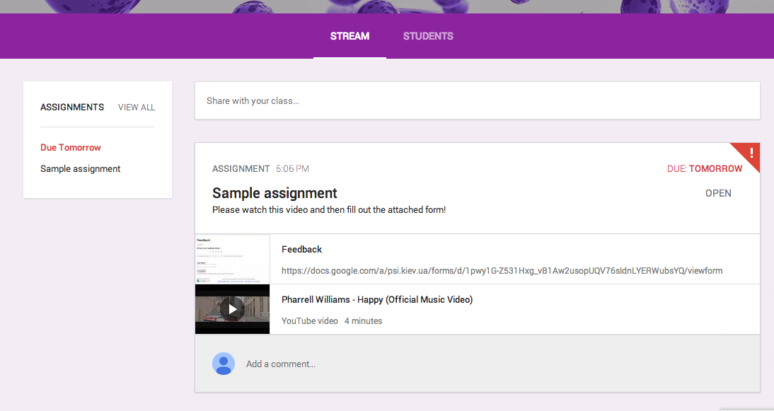
Google Classroom

Slide 16

Fourth Grade Honors
Fourth grade will be included with grades 5-8 for honors.
Second Honors: 88 and Above
First Honors: 92 and Above
Distinguished Honors: 95 and Above

Slide 17

Transportation
Please do not e-mail changes of transportation. It is best to send a note in about dismissal changes. It is very important that I receive a note about any change in transportation. If it is a last minute change, it is best to call the office and they will notify me.
Students cannot switch buses to go home with a friend.

Slide 18

Birthday Celebrations
You may send in a “nut free” snack to celebrate your child’s birthday.
Please do not send in birthday invitations to be distributed in class unless everyone is invited. If it is a girl party and all of the girls are invited, you may send them in. The same policy goes for the boys.
There is a class list (first name only) posted on my website.

Slide 19
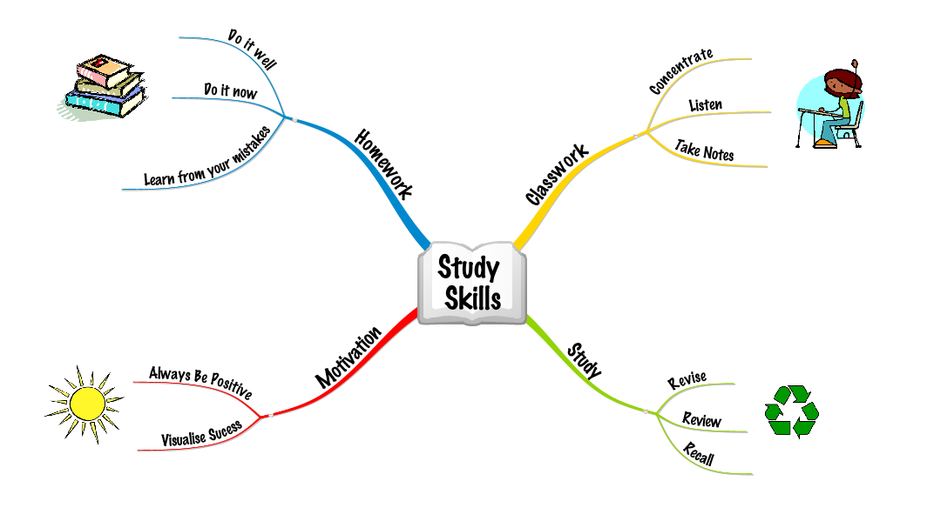
Study Skills
It is very important for students to begin learning good study skills and to prepare ahead of time for all tests.
Using index cards can be a helpful way to introduce study skills.

Slide 20
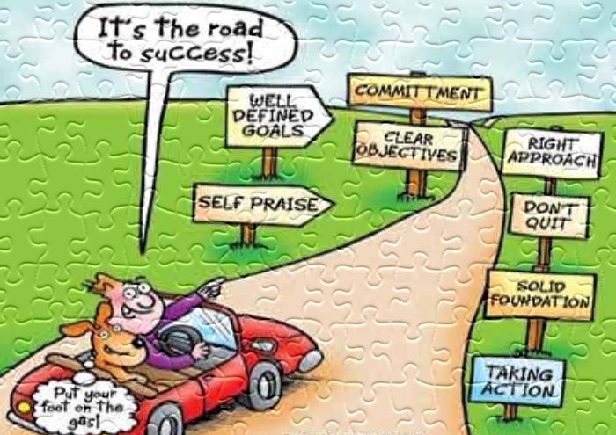
Tests
All tests will be sent home in a test folder. The test folder goes home on Fridays. The students should have all tests signed and the folder returned by Monday.
Please do not write comments on tests. It is best to email me or send in a note if you have any questions .
I update grades online each time tests are sent home.
There are no retests or extra credit. Students are aware that I mark blanks as incorrect answers and for spelling tests I will mark things wrong if I cannot tell what a letter is.

Slide 21

Class Rules
Faith
1. Believe in God and in one another
2. Pray to God
3. Be respectful at Mass
Integrity
1. Never give up
2. Listen to Mrs. Griffith and raise your hand to talk
3. Be honest and responsible in school
Service
1. Help others
2. Keep our school clean
Heart
1. Follow the Golden Rule (WWJD)
2. Include everyone
3. Follow safety rules
4. Respect all people and use good manners
5. Share with others

Slide 22
Behavior Policy
*There are certain behaviors that would not follow this guideline and would be handled on a case by case basis.
1st Warning- A verbal warning will always be given to a student for misbehavior in class.
2nd Warning- The student will be issued a yellow card for their misbehavior.
3rd Warning- The student will receive a Discipline Notice.
Below is the system used for Discipline Notices for grades 4-8:
Discipline Notice 1, 2 and 3- There will be a parent/teacher conference either in person or via the phone after Discipline Notice 3. The teacher initiates the conference.
Discipline Notice 4, 5, and 6- There will be a parent/principal/teacher/student conference in school after the 6th Discipline Notice. The homeroom teacher will initiate the plans for the conference.
Discipline Notice 7, 8, and 9- After a 9th Discipline Notice, the student becomes a candidate for suspension. The principal and pastor will review previous notices and inform all parties of the decision. If a suspension occurs, then the suspension process will proceed.

Slide 23

Homework
Students are responsible for copying their homework correctly and bringing home the correct books.
Students cannot come back to school for books. I tell the students what books to pack up at the end of the day.
If a student is absent from school, he/she will be given the assignments upon returning and it would have to be completed the following day. If a student is out for multiple days, they can take a few days to complete missed work.

Slide 24
Homework
Each time a student misses an assignment, a note will be sent home to notify parents of the missed assignment and a point will be deducted from his/her homework grade.
There will be a total of 60 points given for homework in ELA and Math and this will equal 5% of their total grade in these subjects.
It is a school policy that students receive homework after they return from trips.

Slide 25

Field Trips
All chaperones MUST have their clearances.
  Visit the school website for information on attaining your clearances
If not all chaperones are able to come with the school due to bussing, etc:
  They will be randomly chosen
  Parents will have to option of meeting at the location of the field trip

Slide 26

The best way to communicate with me is by sending an e-mail or writing a note.

