Slide 1
Nutrition

Slide 2
Digestion
The process of breaking down carbohydrates into small sugar molecules (glucose)

Slide 3
Where does your body get its energy?
From food that we eat every day

Slide 4
What is a nutrient?
Any material that can be taken into your body cells and is useful to your body
What is nutrition?
The study of nutrients and the effect they have on health
Does everyone have the same nutritional needs?
No! It depends on your age, body size, and level of activity

Slide 5
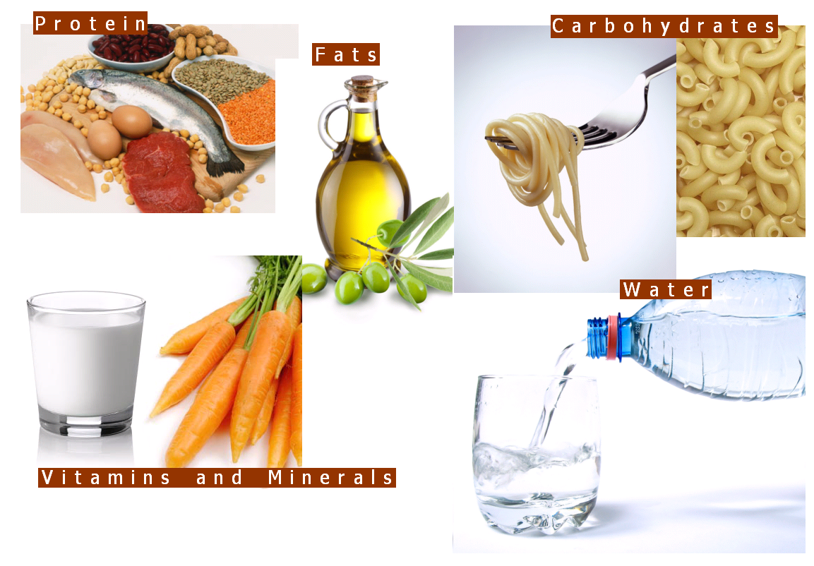
6 Groups of Nutrients:
carbohydrates
fats
proteins
minerals
vitamins
water

Slide 6
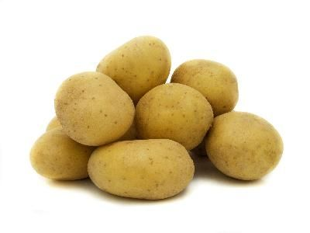
Carbohydrates
The major source of energy for your body
Two groups:
simple – sugars – easily digested
Complex –large sugar molecules, starches, and glycogen – take longer to digest

Slide 7
Fats
Store energy for future use
Keep the body warm
Protect the body
Two types:
Saturated – animal fats
Unsaturated – plant based
Saturated fats increase blood cholesterol – heart disease

Slide 8
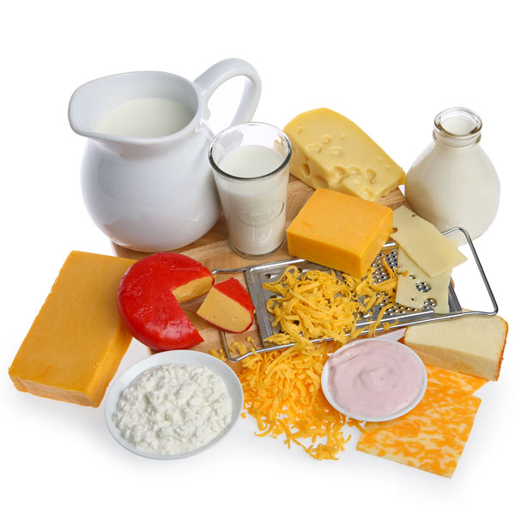
Protein
Responsible for growth and repair of body cells
Made up of amino acids
Humans need 20 amino acids
10 essential
10 non essential

Slide 9
Vitamins
Help your body perform certain functions
Help provide the nutrients that your cells, tissues and organs need.
Some stored, some not

Slide 10
Vitamins
Vitamin A – night vision – carrots
B vitamins – help get energy from foods
Vitamin C – helps absorb iron
Vitamin D – helps with calcium absorption
Vitamin E – anti-oxidant
Vitamin K – blood clotting

Slide 11
Minerals
More elements that the body needs to function properly
Most important is calcium
Growth and repair of bones and teeth

Slide 12
Minerals
Iron – helps blood carry oxygen
Manganese -helps the body form connective tissue, necessary for normal brain and nerve function.
Zinc - heal wounds and plays an important role in the immune system
Phosphorous – works with calcium
Magnesium – needed by every organ
Copper – helps make red blood cells

Slide 13
Water
The most important nutrient
Essential for ALL cells
5 functions:
takes nutrients to cells
carries waste products away from cells
cools the body – sweat
lubricates joints
saliva

Slide 14
Fiber
Not a nutrient, but still important
Complex carbohydrate
Fruits and vegetables
Wholegrain cereals
Helps the body move waste more easily

Slide 15
My Plate
identifies daily meal proportions for five food groups
easy-to-understand illustration designed to help Americans build a healthy plate at meal times.

Slide 16
My Plate
The MyPlate logo divides a dinner plate into four sections
vegetables
fruits
grains
proteins
fifth smaller plate to one side for dairy.
The fruit and vegetable portions make up half of the plate - include fruits and vegetables as half of every meal.

Slide 17
My Plate Suggestions:
Make half your plate fruits and vegetables.
Switch to fat-free or low-fat (1%) milk.
Make at least half your grains whole grains.
Go lean with protein.
Compare sodium (salt) in foods like soup, bread, and frozen meals, and choose foods with lower numbers.
Drink water instead of sugary drinks.
Find a balance between food and physical activity.
Enjoy your food, but eat less.
Avoid oversized portions

